Slide 1
IBM University Engagement Project Submission

Slide 2

Project Tile – [AI Grant And Funding Finder For Startups]
Domain of Project – [Startup Ecosystem/ GovTech / Artificial Intelligence
]
Student Name | Recent Passport Photo | Email ID | Mobile number [WhatsApp]
Konda sharanya |  | kondasharanya1601@gmail.com | 7569442853

Slide 3
Problem Statement -
Problem Statement: AI Grant & Funding Finder for Startups
The Challenge
Startups struggle to find suitable grants because funding information is scattered across multiple platforms.
Different formats, eligibility criteria, and deadlines make grant discovery complex.
Extracting funding details from unstructured content requires intelligent analysis.
The Objective
• Discover grants from government and private funding sources.
• Extract eligibility criteria, deadlines, and funding details using IBM Granite.
• Match startup profiles with relevant grant opportunities.
• Generate AI-powered grant proposals automatically.
• Provide recommendations, match scores, and deadlines through an interactive dashboard.

Slide 4
Proposed Solution -
Proposed Solution: AI Grant & Funding Finder for Startups
The proposed solution is an AI-powered platform built using IBM Granite, watsonx.ai, LangFlow, and IBM Cloud Lite Services.
• Grant Discovery Agent – Collects funding opportunities from multiple sources.
• Eligibility Extraction Agent – Extracts grant requirements and deadlines.
• Grant Matching Agent – Matches startup profiles with suitable grants.
• Proposal Generation Agent – Creates funding application drafts automatically.
• LangFlow orchestrates multi-agent workflows and automation.
• IBM Granite powers eligibility analysis, matching, and proposal generation.
• SQLite stores startup profiles, grant data, and generated proposals.
• Interactive Dashboard displays recommendations, match scores, and deadlines.
• Simplifies funding discovery and improves startup access to grants.

Slide 5
Technology Used
Technology Used
• IBM Granite (granite-13b-chat-v2) – Eligibility extraction, grant matching, and proposal generation.
• IBM Cloud Lite Services – Secure and scalable cloud infrastructure.
• IBM watsonx.ai – Model deployment, inference, and AI governance.
• LangFlow – Visual orchestration of multi-agent workflows.
• FastAPI – Backend API development and service integration.
• HTML, CSS & JavaScript – Interactive user dashboard.
• SQLite + SQLAlchemy – Stores startup, grant, and proposal data.
• Grant Discovery Engine – Aggregates funding opportunities from multiple sources.
• Docker & Docker Compose – Simplifies deployment and scalability.
• Python – Core programming language for application development.

Slide 6
Langflow component Used -
Chat Input – Accepts startup details and funding requirements.
IBM watsonx.ai Agent – Processes startup and grant information.
IBM Granite Model – granite-13b-chat-v2 for matching and proposal generation.
Grant Discovery Agent – Collects opportunities from multiple funding sources.
Startup Profile Component – Stores startup information for recommendations.
Eligibility Extraction Agent – Extracts requirements and deadlines.
Grant Matching Agent – Generates grant compatibility scores.
Proposal Generation Agent – Creates grant application drafts.
Chat Output – Displays recommendations, scores, and proposals.
Dashboard Component – Shows grants, deadlines, and funding insights.

Slide 7
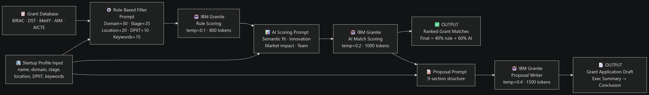
Langflow workflow -

Slide 8
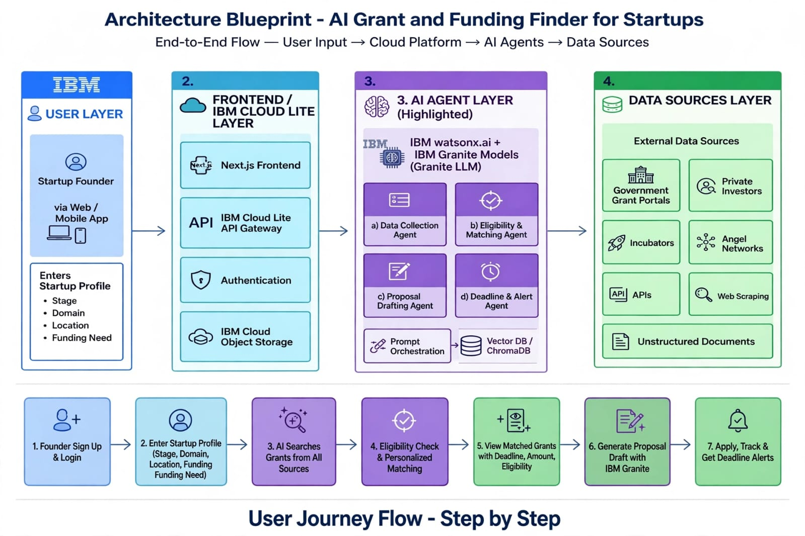
Architecture blueprint

Slide 9

Role of Agentic AI in the solution
• Agentic AI enables the platform to act as an intelligent funding assistant.
• IBM watsonx.ai and IBM Granite power autonomous decision-making.
• Grant Discovery Agent gathers funding opportunities from multiple sources.
• Eligibility Extraction Agent analyzes grant requirements and criteria.
• Grant Matching Agent generates personalized grant recommendations.
• Proposal Generation Agent creates funding application drafts automatically.
• Multiple agents collaborate to improve accuracy and efficiency.
• The system understands startup profiles, domains, and funding needs.
• Real-time updates ensure relevant recommendations and opportunities.
• Acts as a smart digital funding advisor for startups.

Slide 10
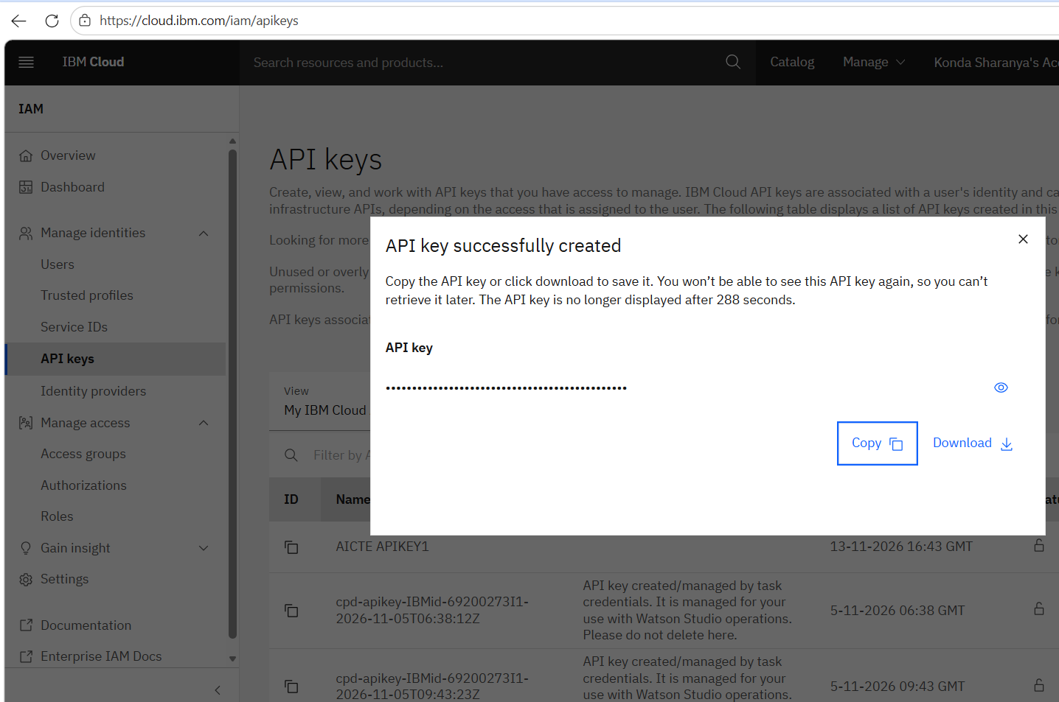
·
·
·

Slide 11
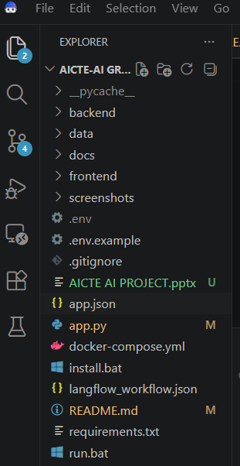

Slide 12
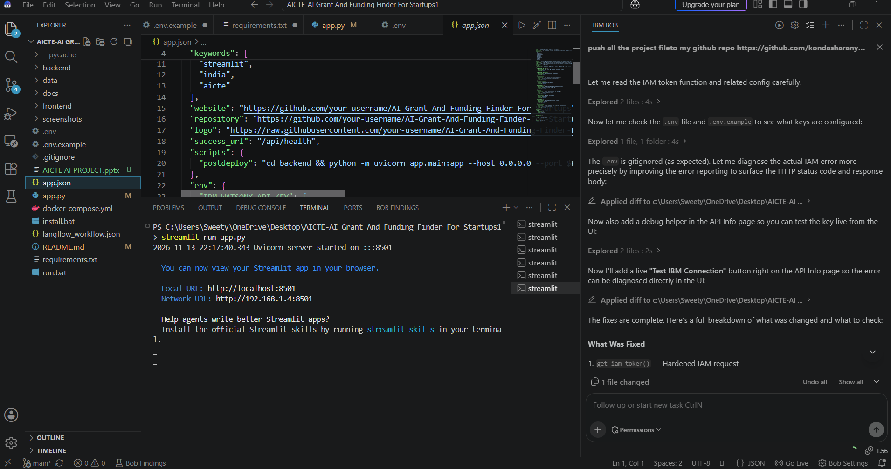

Slide 13
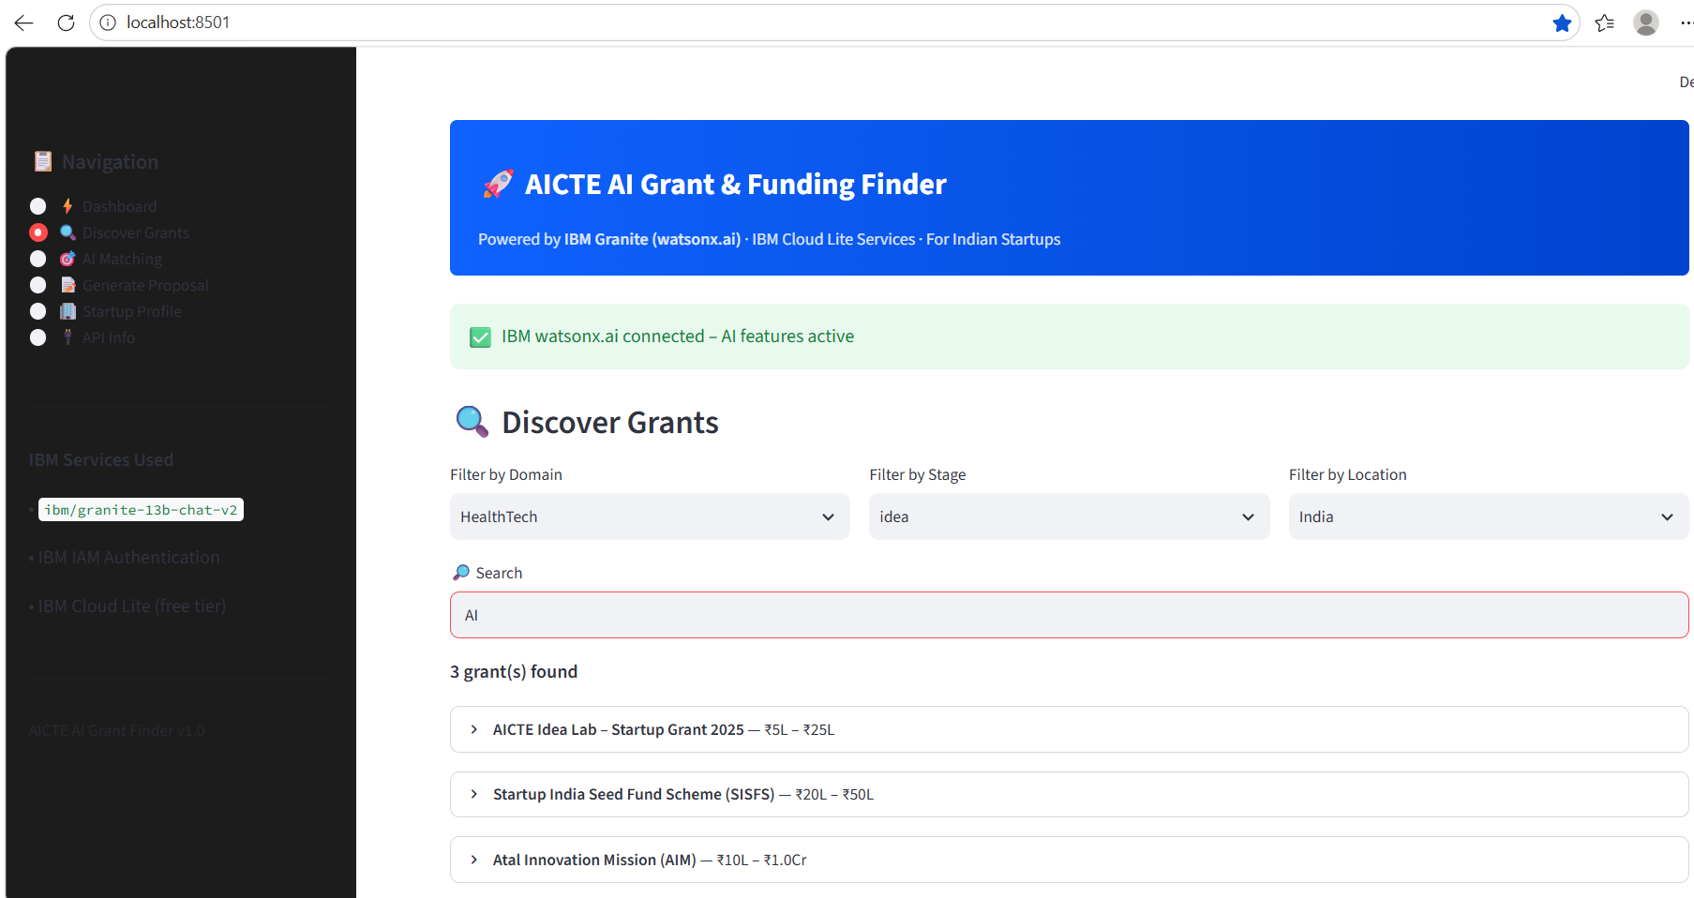

Slide 14
Novelty and Uniqueness
The AI Grant & Funding Finder is an intelligent platform that helps startups find suitable government funding opportunities.
It uses Agentic AI, where multiple AI agents work together to search, analyze, and recommend grants.
It uses IBM Granite Models to understand startup details and funding requirements.
A Hybrid Scoring System combines rule-based methods and AI scoring to rank suitable grants.
It provides personalized recommendations based on startup domain, stage, location, and DPIIT registration.
It automatically extracts important details such as eligibility, deadlines, and funding requirements.
It generates grant proposals, executive summaries, and application drafts using IBM Granite.
It discovers funding opportunities from sources like AICTE, BIRAC, DST, MeitY, and AIM.
It uses IBM watsonx.ai, LangFlow, and IBM Cloud Lite Services to build an intelligent and scalable platform.
Overall, it acts as a smart digital funding advisor, helping startups save time and find the right funding opportunities.

Slide 15
Git Hub Link
Please create public github repository (Enable Add README button while creating repository) with format –
https://github.com/kondasharanya/AICTE-PROJECT.git
·
·
·

Slide 16
Future Scope
1. Integration with Real-Time Grant & Funding APIs
The platform can be integrated with government, private, and international funding APIs to provide real-time grant updates, deadline notifications, and newly launched funding opportunities. This will ensure startups always receive the latest funding information without manual searching.
2. Global Funding Ecosystem Expansion
Future versions can support international grants, accelerator programs, venture capital opportunities, and startup competitions, enabling startups to access funding sources beyond their local region.
3. Automated Application Submission & Tracking
The platform can be extended to automatically track application status, send deadline reminders, and assist users throughout the grant application lifecycle, reducing administrative effort and improving success rates.
·
·
·

Slide 17
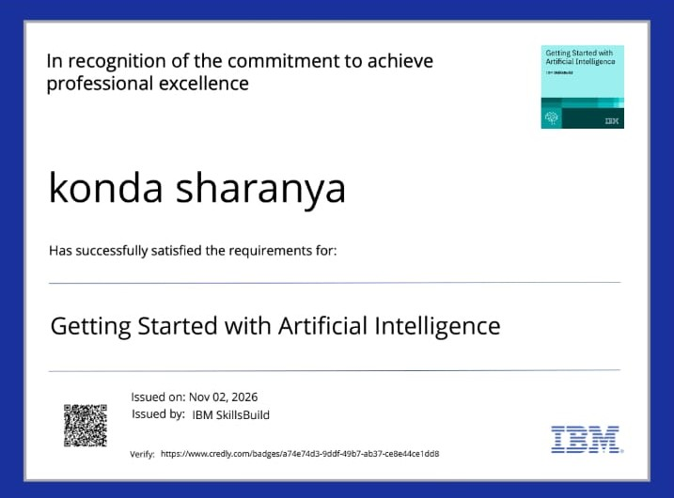
Certificates Earned:

Slide 18
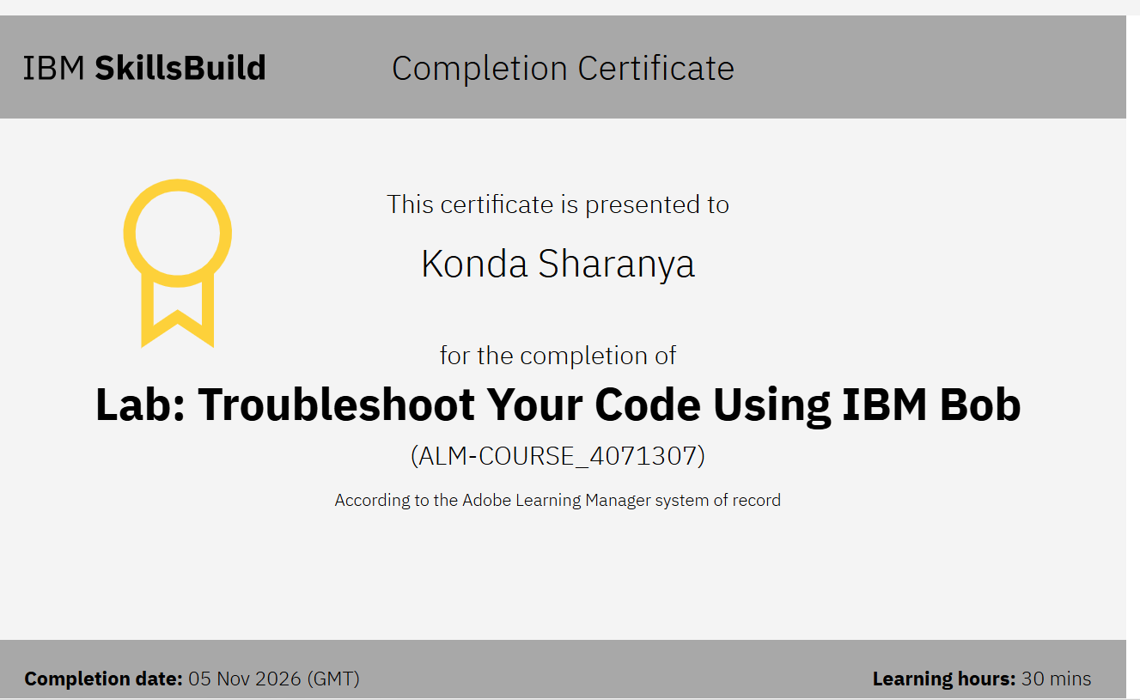
Certificates Earned:​

Slide 19
THANK YOU

